Slide 1
Extractive Industries Transparency Initiative
in Germany

Slide 2
D-EITI-Presentation
A collection of slides
January 2024

Slide 3
Contents
What is the EITI?
Why the EITI in Germany?
The EITI in Germany
Current implementation status of the EITI in Germany
D-EITI and the EU Accounting Directive
D-EITI photos
More information and contact

Slide 4
1. What is the EITI?

Slide 5
What is the EITI?
The Extractive Industries Transparency Initiative (EITI) was founded in 2003. It is an international standard to promote a transparent and accountable management of natural resources in the oil, gas and mining industries.
Countries that implement EITI commit to publish key information on their national extractive sectors, such as tax payments, licenses, contracts and production data.

Slide 6
Why is EITI globally important?
Improved management of public revenues
Improved investment climate
More favourable loans
The fight against corruption
Information dissemination to and participation of the population

Slide 7





On which topics does the EITI focus?
Legal and institutional framework | How are licenses and contracts awarded and recorded in registers? Who are the beneficial owners of the extractive companies? Which tax and legal agreements exist?
Production | Which raw materials are extracted? How large are the extracted amounts?
Generation of revenues | How much is paid (e.g. taxes, royalties)?
Distribution of revenues | Where do the revenues go?
Social and economic contribution | What does the extractive industry contribute to the national economy – and especially to employment?
Source: International Secretariat

Slide 8



How does the EITI work?
A national multi-stakeholder group (MSG) (government, private sector, civil society) decides on the shaping of the EITI process
Key information about the extractive sector is published annually in an EITI report.
This information stimulates a public dialogue about how raw materials can be better managed.

Slide 9
Facts and figures about the EITI
57
countries implement the EITI standard
More than 3,11 trillion USD
government revenues were disclosed
More than 540 fiscal years
were disclosed in open data format
More than 250
NGOs are committed to the EITI – locally and internationally
More than 60
large extractive companies officialy support the EITI
Source: International Secretariat (January 2024)

Slide 10
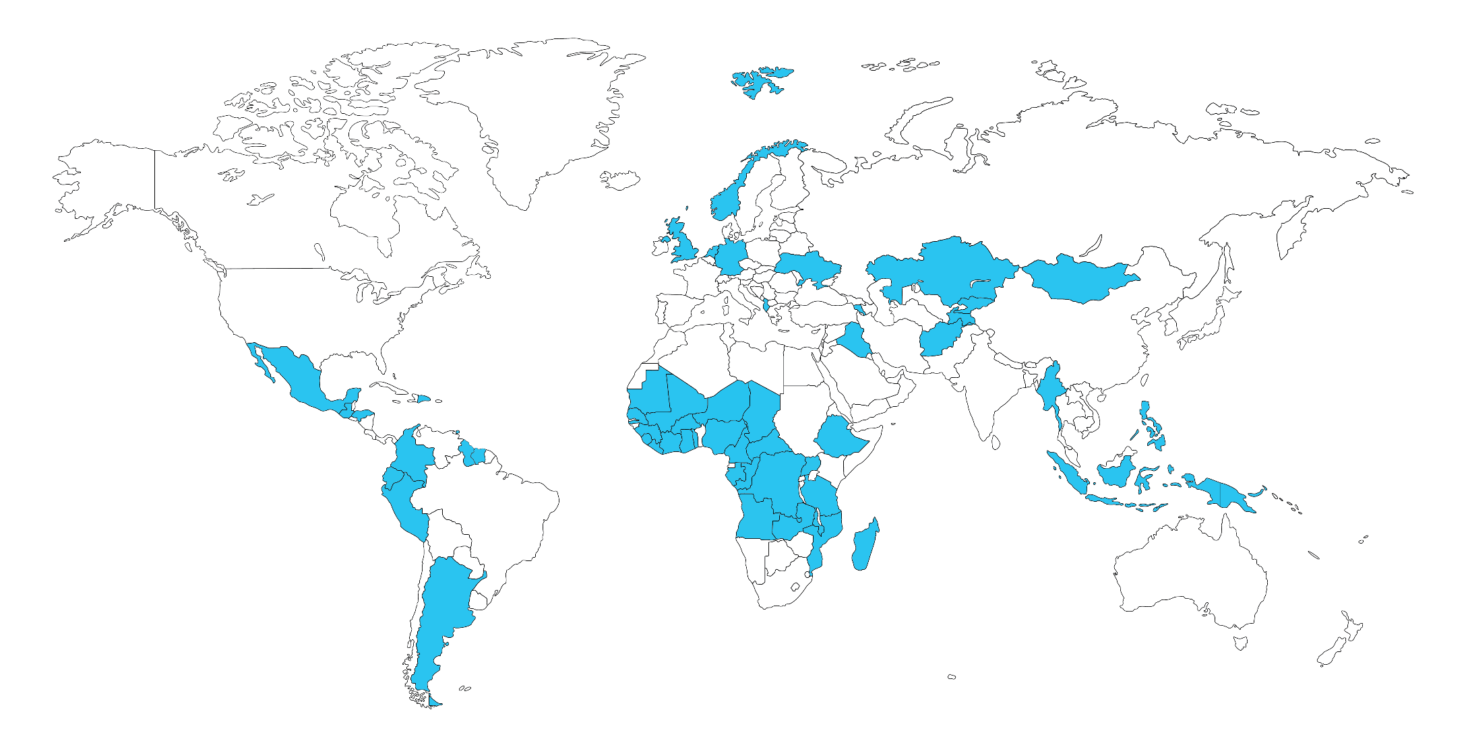
EITI-countries
Two EU countries
Six OECD countries
Two G7 countries
Status of the map: March 2022

Slide 11
2. Why the EITI in Germany?

Slide 12
Why is Germany implementing the EITI?
Germany is a long-time supporter of the initiative at international level and has been implementing EITI in Germany since the beginning of 2016.
  Supporting the international agenda for the creation of fair global rules (level playing field) and for the fight against corruption
  Objectifying the discussion and increase understanding of domestic extraction of natural resources
  Preparing German industry for international transparency requirements
  Implementing the principles of open data: improving affiliation with citizens, service quality and innovation in the public administration
  Multi-stakeholder model as an innovative forum and a pioneer for dialogue

Slide 13
3. EITI in Germany
The multi-stakeholder group (MSG)
Objectives
D-EITI history

Slide 14
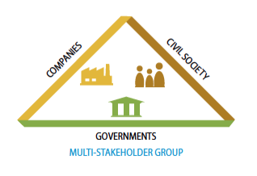
Who is implementing the EITI in Germany?
A national Multi-Stakeholder Group (MSG) consisting of representatives from government, private sector and civil society decides on the shaping of the EITI process.

Slide 15














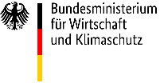


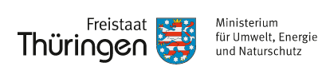

The MSG of the German EITI

Slide 16
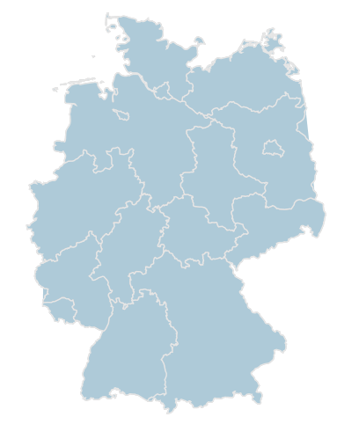


Implementation of the EITI in a federal state
EITI reporting primarily relates to the mandates of the Federal States.
The provincial governments were involved in the multi-stakeholder process from the outset, in the form of a Federal-State Working Group (WG).

Slide 17

D-EITI Special Representative: Dr. Franziska Brantner
Special Representative of the Federal Government for the
implementation of the EITI in Germany
Parliamentary State Secretary at the Federal Ministry for Economic Affairs and Climate Action.
© BMWK/ Susanne Eriksson

Slide 18
The MSG has set seven objectives with respect to D-EITI (1/2)
Produce timely reports that are understandable and accessible to the general public and based on a transparent, open and innovative EITI process in Germany.
Process contextual information concerning the German extractive sector, with a view to promoting a broad debate on resource policy that includes aspects of sustainability (economic, environmental, and social).
Engage in understandable, commensurate and increasingly comprehensive reporting to the general public in compliance with the EITI Standard and in harmony with the EU Accounting and Transparency Directives. Concomitantly, additional value shall be generated.
Contribute to the further development of the EITI Standard and its implementation and acceptance as a de-facto global standard, to support the global striving for transparency and accountability as well as the fight against corruption in the extractive sector.

Slide 19
The MSG has set seven objectives with respect to D-EITI (2/2)
Share experience from the multi-stakeholder process, in particular with respect to participatory democracy, citizen engagement and knowledge transfer, and also with regard to EITI implementation in a federal state.
Substantially enhance Germany’s credibility as regards its political and financial support for EITI.
Ensure ongoing implementation of the D-EITI with the intended multi-stakeholder model while building capacity for broad-scale public debate.

Slide 20
The seven D-EITI objectives can be grouped into three topics
Development of an UNDERSTANDABLE D-EITI REPORT, one which promotes the dialogue on the national extractive sector.
Contribution to the development of the EITI standard as a GLOBAL TRANSPARENCY STANDARD.
SHARING OF KNOWLEDGE and experiences regarding the multi-stakeholder process in a federal state.

Slide 21
To become an EITI-compliant country, Germany must go through several steps
EITI- Pilot
EITI compliant country
Adoption
of candidacy
1st D-EITI report
1st Validation
EITI-compliant country
Annual D-EITI reports
Payment Reconciliation Pilot
2021
2nd Validation
2023
EITI candidacy country

Slide 22
From preparatory group to EITI-compliant country – what has the D-EITI already achieved?
I
II
III
IV
V
VI
VII
VIII
Public statement of intention to implement the EITI
Appointment of a senior official as EITI representative
Transparency
summit
26/11/14
First meeting
of the MSG
Scoping-Study
EITI candidacy application with work plan
Adoption of the candidacy
First D-EITI report
Jul 2014
✓
Jul 2014
✓
Nov 2014
✓
Mär 2015
✓
Mär 2015
✓
Dez 2015
✓
Feb 2016
✓
Aug 2017
✓
IX
X
XI
XII
XIII
XIV
XV
XVI
XVII
Update of the first D-EITI report
Start of 1st Validation
EITI- compliant country
Second D-EITI report
Third D-EITI report
Fourth D-EITI report
Fifth D-EITI report
Start of 2nd Validation
Sixth D-EITI report
Okt 2018
✓
Nov 2018
✓
Mai 2019
✓
Dez 2019
✓
Feb 2021
✓
Feb 2022
✓
Feb 2023
✓
Okt 2023
✓
Dez 2023
✓

Slide 23
From candidacy to EITI-compliant country – continuous implementation by the D-EITI
Special Topics
XI
EITI- compliant country
Annual reports
Systematic Disclosure
May 2019
✓
Validations
New EITI Requierements

Slide 24
4. Current EITI implementation status in Germany

Slide 25
Sixth D-EITI report published
Since May 8th 2019 Germany is an EITI-compliant country.
The MSG published the 6th D-EITI report in December 2023.
6. D-EITI report
Start of the
2. Validation
Update 5. D-EITI report
4. D-EITI report
3. D-EITI-report
EITI-compliant country
1. Validation
1. D-EITI-report
Adoption of candidacy

Slide 26
Topics of the D-EITI report
The extractive industry in Germany
Which raw materials are extracted and where?
Focus: oil, natural gas, coal, potash and salts, earth and stone, and industrial minerals and metals
Which revenues are generated by the extractive industries?
incl. corporation tax, mine site and extraction royalties
Special Topics
incl. dealing with human intervention in nature and landscape, state subsidies and tax concessions, renewable energies, environmental protection, recultivation and renaturation, employment and social affairs, circular economy, especially recycling as well as effects of the energy transition and structural change on raw material extraction in Germany.
From 2023: Contribution of domestic raw material extraction to security of supply, including Germany's role in the international raw materials market
State administration of the extractive industry
incl. who owns raw materials?, legal framework, licenses
Importance of the extractive industry in Germany
Contribution to GDP, to government revenue, employment and exports

Slide 27

D-EITI report: Highlights
The report contains comprehensive information about the German extractive sector.
The MSG has included compensation measures, circular economy in particular recycling, employment and social affairs and natural resource demand in the field of renewable energies as additional topics that are not specified by the EITI standard.
All contents were developed by the three stakeholder groups and decided by consensus.
All information is also available on the interactive report portal www.rohstofftransparenz.de. All data is available in Open Data Format.

Slide 28
Payments 2021 – 6th D-EITI Report
The following overview shows the payments made in 2021 by the participating companies to government agencies including corporation tax, trade tax, mine site and extraction royalties as well as lease payments and payments for infrastructure improvements.
 | Corporation tax EUR | Trade tax EUR | Extractive & mine site royalties EUR | Lease payments EUR | Payments into the infrastructure EUR | Total EUR
Total amount of reported payments from all companies | 46.950.099,80 | 62.263.317,51 | 81.276.782,23 | 3.551.645,49 | 21.725.542,45 | 215.767.387,48
In the 6th D-EITI report, the D-EITI has decided to continue and further develop the alternative approach for the quality assurance of data tested for the first time in the 3rd D-EITI report, especially in the area of trade taxes.
The alternative approach builds on a comprehensive presentation of systems and processes underlying the payment flows. Depending on the result of the risk assessment the procedure for quality assurance is selected.

Slide 29
5. D-EITI and EU Accounting Directive

Slide 30
D-EITI and EU Accounting Directive
With the Accounting Directive Implementation Act (Bilanzrichtlinie-Umsetzungsgesetz) transparency regulations for companies in the extractive sector and their payments to government agencies were incorporated into the German Commercial Code (Handeslgesetzbuch).
By closely linking D-EITI reporting with statutory reporting and disclosure requirements extra burdens for companies were avoided.

Slide 31
Comparison of the D-EITI and the German Commercial Code
 | German Commercial Code | D-EITI
Materiality threshold | €100.000 per payment | €100.000 per payment
Criteria for the size of companies* | Balance sheet total: €20 revenues: €40 million 250 employees | Balance sheet total: €20 revenues: €40 million 250 employees
Information that gives the general public an overview of the extractive sector operations | n.a. | Provided in the context report
Cross-interest dialogue on the contribution of the extractive sector in Germany | n.a. | Through the Multi-Stakeholder Group
Is reporting mandatory? | Yes, penalty payments are due in case of violations | No, no sanctions for companies, but possible threat to EITI status
* "Large" in the legal sense is defined as companies that exceed at least two of the three criteria mentioned above on two consecutive balance sheet dates (§ 267 Abs. 3 HGB).

Slide 32
6. D-EITI photos (as of 2019)

Slide 33
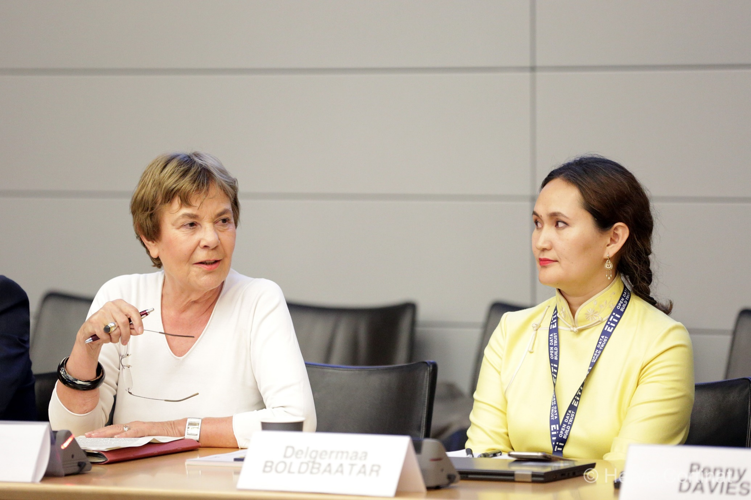
MSG member Prof. Edda Müller (left) at the EITI World Conference 2019 in Paris

Slide 34
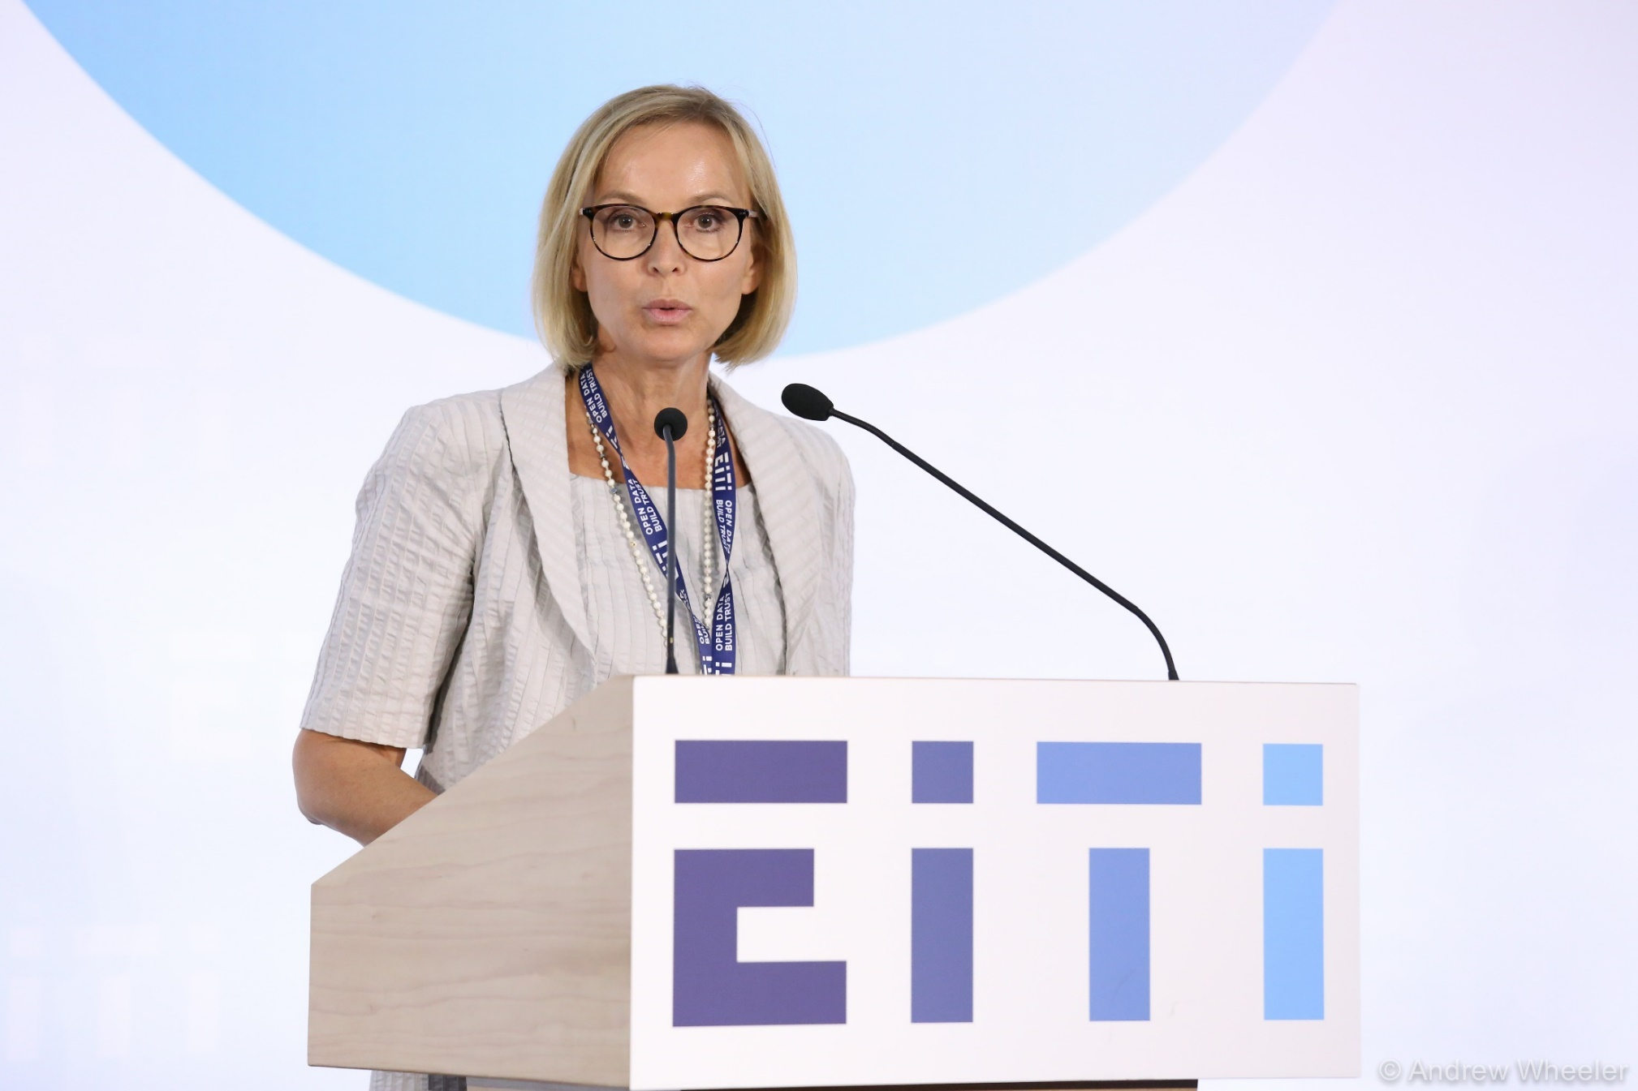
MSG Vice Chair Andrea Jünemann at the EITI World Conference 2019 in Paris

Slide 35
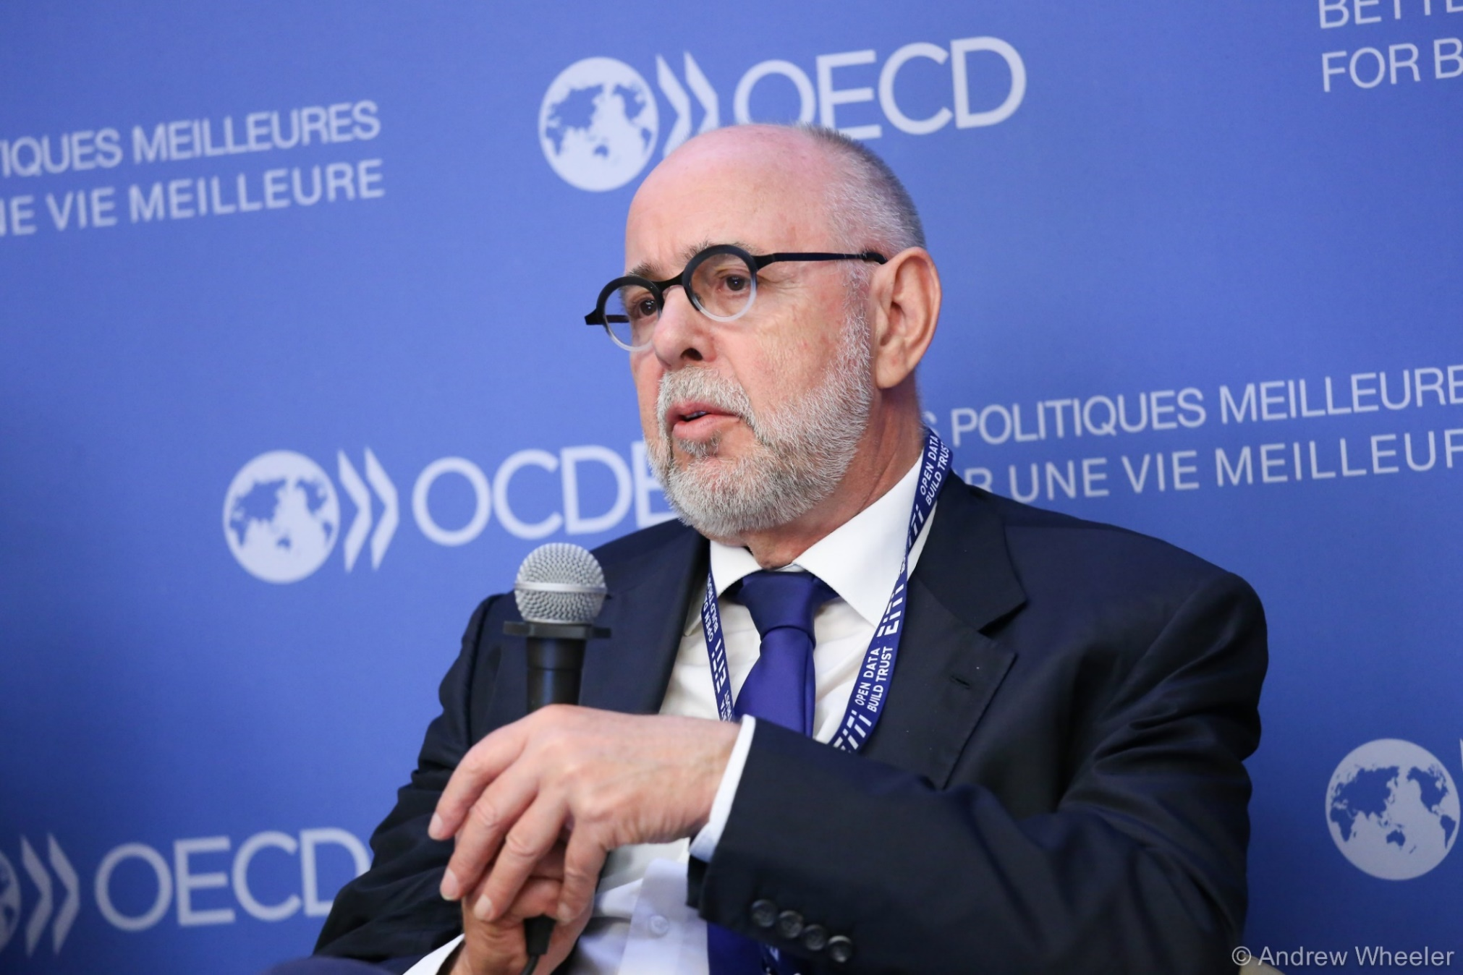
MSG member Friedrich Wilhelm Wagner at the EITI World Conference 2019 in Paris

Slide 36
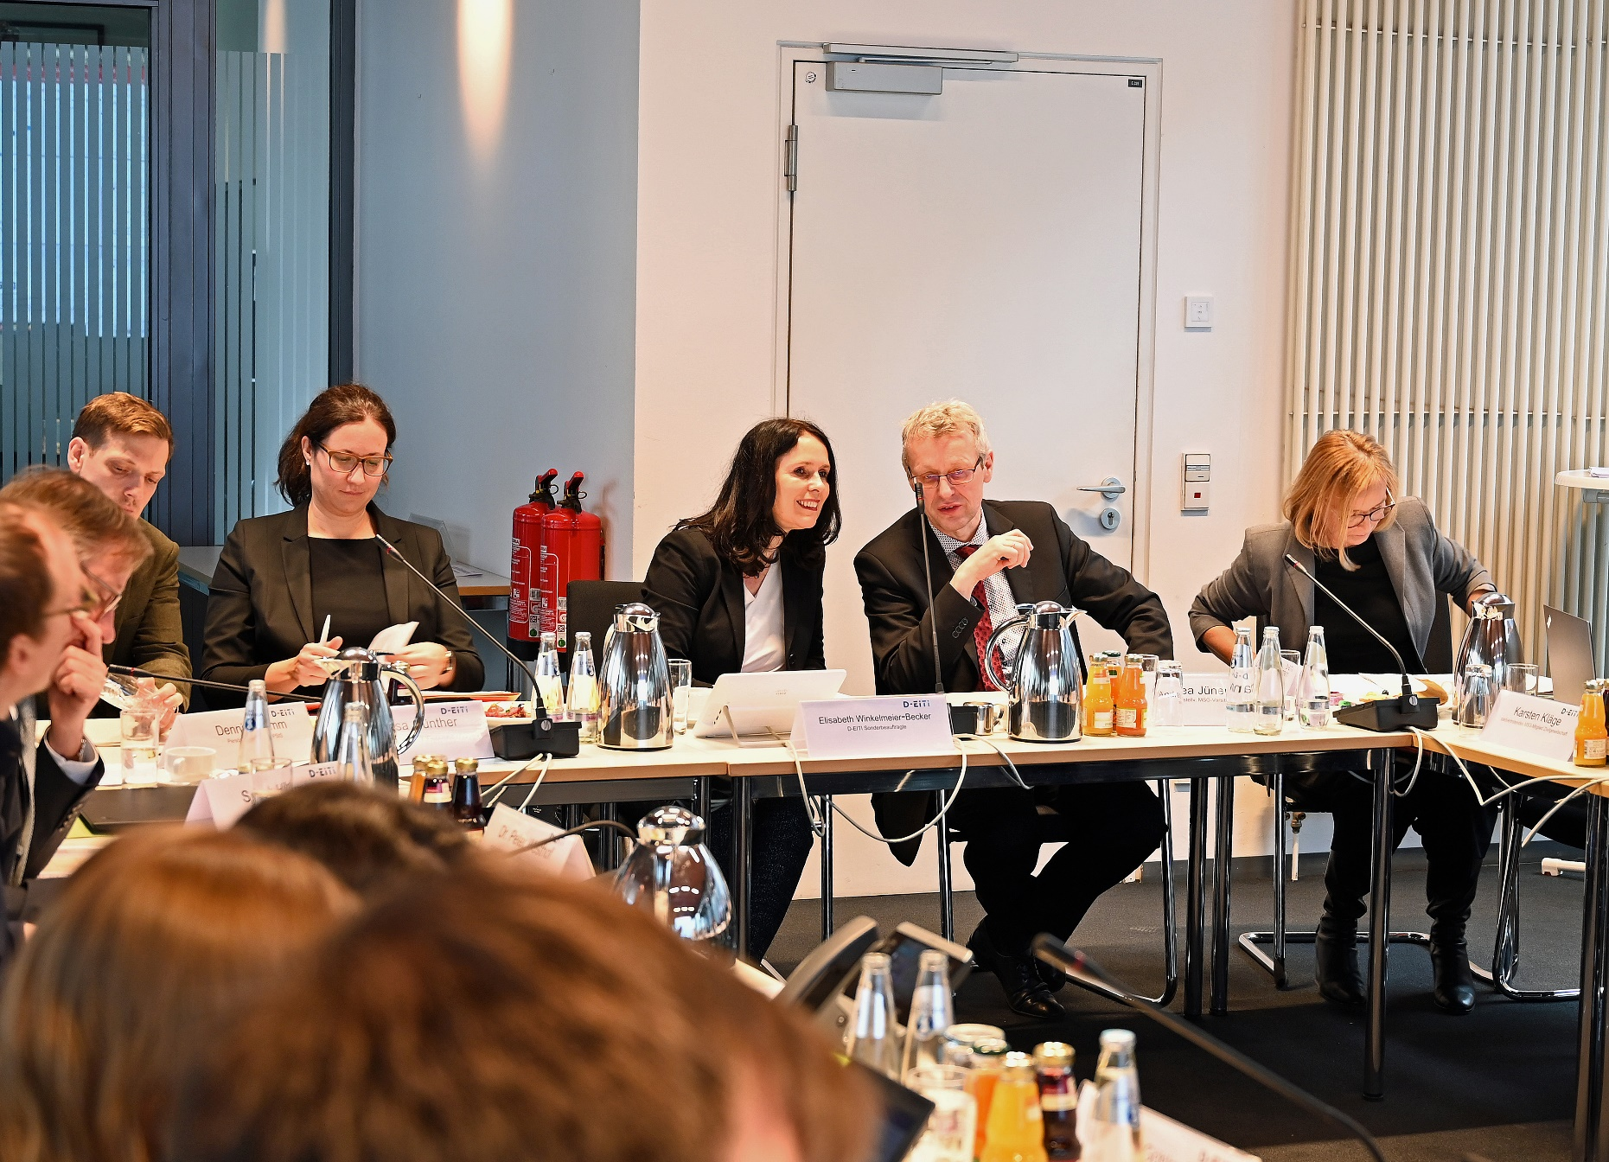
Impressions of the 17th MSG meeting (February 2020) at the Federal Ministry of Economics and Energy

Slide 37
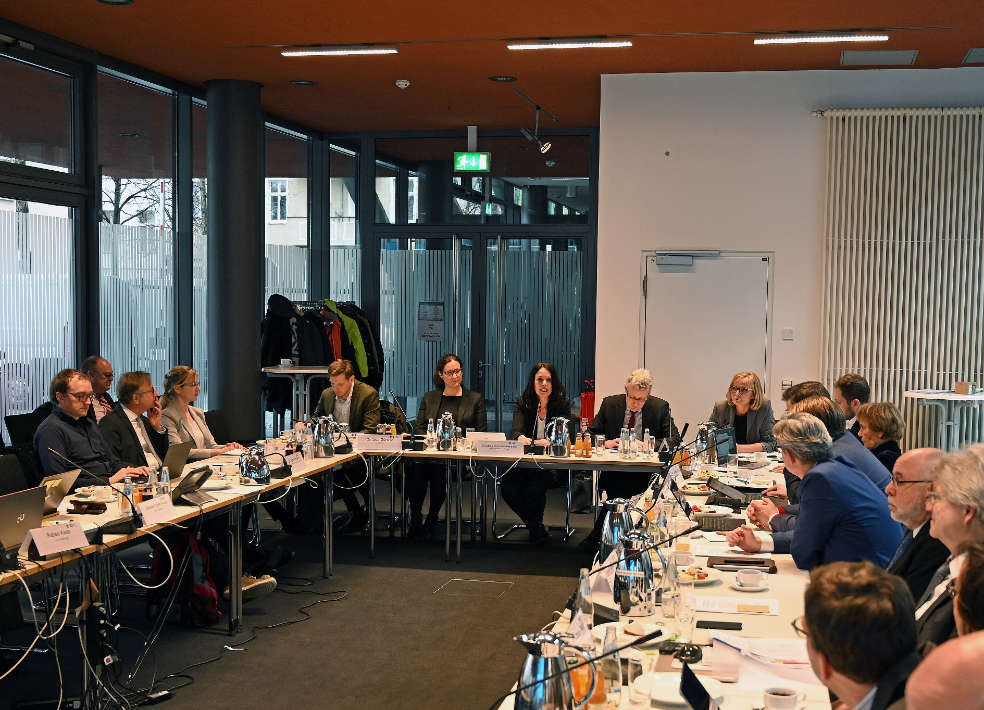
Impressions of the 17th MSG meeting (February 2020) at the Federal Ministry of Economics and Energy

Slide 38
7. More information and contact

Slide 39


More information about D-EITI
http//: Internetseite
www.D-EITI.de
@ Kontakt
sekretariat@d-eiti.de
D-EITI-Newsletter
www.d-eiti.de/kontakt-newsletter-abonnieren/
Facebook
www.facebook.com/EITIDeutschland
Twitter
@EITIDeutschland

Slide 40
Contact
D-EITI-Secretariat
Reichpietschufer 20
10785 Berlin
Tel.: +49 30 – 72 614 – 319
Fax: +49 30 – 72 614 – 22 319
E-Mail: sekretariat [at] D-EITI.de
www.D-EITI.de
www.rohstofftransparenz.de

